Slide 1
﻿ ﻿ ﻿ ﻿ ﻿ ﻿ ﻿ ﻿ Employee Data Analysis using Excel
STUDENT NAME : syed mufidha Parveen s REGISTER NO : 312214204 DEPARTMENT : B.Com General COLLEGE : St. Thomas college of arts and science

Slide 2
TITLE
Employee Performance Analysis
using Excel

Slide 3
AGENDA
Problem Statement Project Overview End Users Our Solution and Proposition Dataset Description Modelling Approach Results and Discussion Conclusion

Slide 4

PROBLEM STATEMENT
Analyzing employee performance can be a complex task, but Excel provides a powerful toolkit for extracting insights and making data-driven decisions. This presentation outlines our comprehensive employee data analysis solution using Excel.

Slide 5
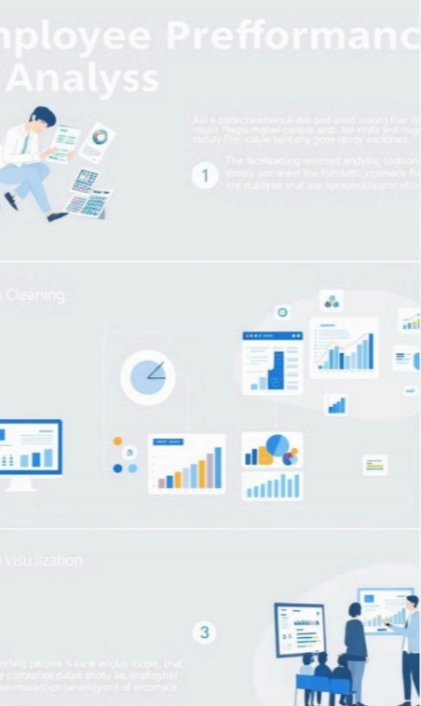
Project Overview:
Understanding Employee Performance
This project aims to leverage Excel’s capabilities to analyse employee performance data and identify key trends, areas for improvement, and potential opportunities for growth.
Data Collection
Gathering relevant data from various sources, such as performance reviews, attendance records, and surveys.
Data Cleaning
Ensuring data accuracy and consistency through data cleansing and transformation techniques.
Data Analysis
Employing statistical functions and visualization tools to identify patterns and insights within the data.
Reporting & Recommendations
Nitrating clear and concise reports that highlight key findings and provide actionable recommendations.

Slide 6
Excel Users:
A Powerful Tool for Data Analysis
Excel is a widely used and versatile tool for data analysis, offering a range of functions, formulas, and visualization capabilities.
Data Manipulation | Data Visualization | Data Analysis
Excel's functions and formulas allow for efficient data manipulation, transformation, and calculation. SUM, AVERAGE, COUNTIF VLOOKUP, INDEX, MATCH IF, AND, OR | Excel provides a variety of charts and graphs for visualizing data trends and patterns. Bar Charts, Pie Charts Line Graphs, Scatter Plots Histograms, Box Plots | Excel offers tools for statistical analysis, such as descriptive statistics, hypothesis testing, and regression analysis. Descriptive Statistics: MEAN, MEDIAN, MODE Regression Analysis: Linear, Multiple Regression T-Tests, ANOVA

Slide 7
Our Solution:
Utilizing Excel for Comprehensive Analysis
Our solution utilizes Excel’s functionalities to conduct a comprehensive analysis of employee performance data, aiming to provide actionable insights and recommendations.
Data Source | Excel Spreadsheet
Data Format | Structured, organized data
Analysis Techniques | Statistical Functions, Visualizations
Output | Comprehensive Report, Visualizations

Slide 8
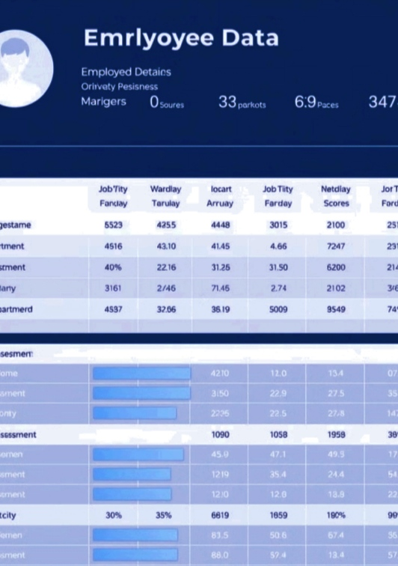
Dataset Description:
Understanding Employee Attributes
The dataset will consist of employee information, performance metrics, and feedback, enabling us to analyse key performance indicators.
Employee Demographics
Name, Job Title, Department,
Location, Experience Level.
Performance Metrics
Productivity Scores, Efficiency
Ratings, Project Completion
Rates, Skill Assessments.
Feedback & Reviews
Manager Feedback, Peer Feedback, Self-Assessments, Performance
Review Scores.

Slide 9
Modelling Approach:
Unveiling Performance Trends
We will utilize Excel's capabilities to build models that reveal hidden trends and patterns in employee performance data.
Data Cleaning & Transformation Handling missing values, standardizing data formats, and transforming data for analysis.
 | Feature selection identifying key variables that have a significant impact on employee performance.
Model Building Constructing models using various statistical techniques to predict or analyse performance.
 | Model Evaluation & Validation Assessing the accuracy and reliability of the model, ensuring its effectiveness for predictions.
Model Deployment & Interpretation Deploying the model for practical applications and interpreting its results to draw meaningful conclusions.

Slide 10
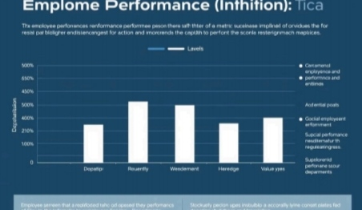
Results and Discussion:
Actionable Insights and Recommendations
The analysis will uncover valuable insights into employee performance, enabling us to identify areas for improvement and provide actionable recommendations.
Departmental Performance
Analyzing performance across different departments can reveal
variations and identify areas for targeted interventions.
Experience & Performance
Understanding the relationship between experience level and performance can guide training and development programs.

Slide 11
The Wow in Our Solution
Automation and Efficiency
Automate data collection and analysis using Excel formulas and macros. This reduces manual effort and improves accuracy. Dynamic Dashboards Create interactive dashboards that allow managers to easily filter, sort, and analyse data in real-time. This provides an at-a-glance view of performance and key trends. Predictive Analytics
Use Excel’s statistical functions to identify patterns and predict future performance. This enables proactive decision-making and interventions.

Slide 12

Conclusion:
A Data-Driven Approach to Employee Performance
By leveraging Excel’s capabilities for data analysis, we can gain valuable insights into employee performance, identify areas for improvement, and develop data-driven strategies for enhancing employee growth and productivity.
Increased Efficiency Identifying areas for process improvement and optimization, leading to higher productivity and efficiency. | Improved Employee Development Tailoring training and development programs to address specific skill gaps and foster employee growth.
Data-Driven Decision Making using data-driven insights to manag. | Enhanced Employee Engagement Creating a more data driven and transparent approach to performance manage.

